Slide 1
Board of Directors Meeting

Slide 2
Agenda
Company Briefing
Financial Update
Sustainability Issues
Proposal
Q&A
Notes:
Hello board of directors and extended audience members, I want to welcome to the final presentation on the health of our business and issues on sustainability. Today I’ll take you through a brief recap about where we are as a company, a financial update since our last meeting, a revisit of our sustainability issues, and finally a proposal.

Slide 3
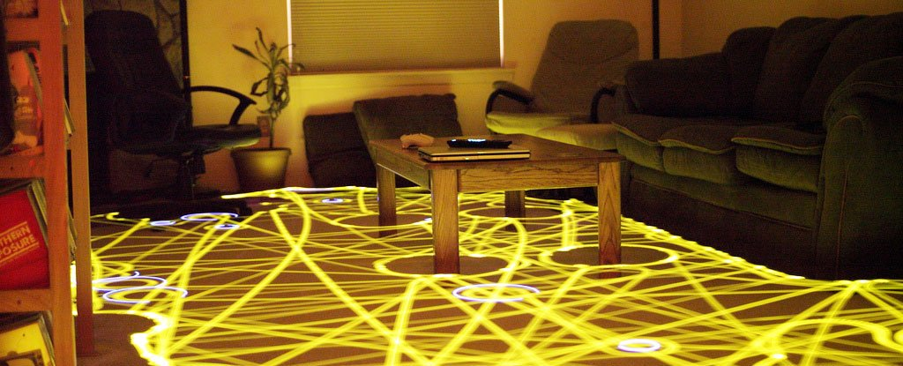
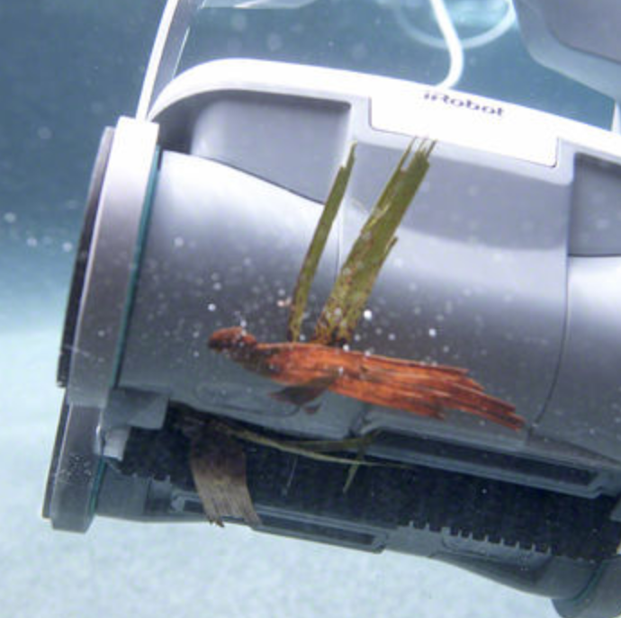
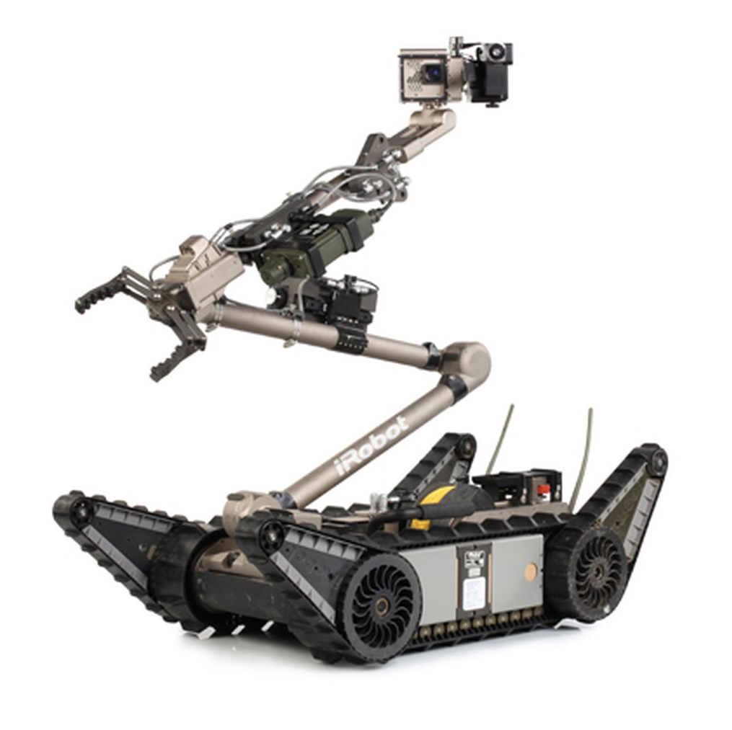
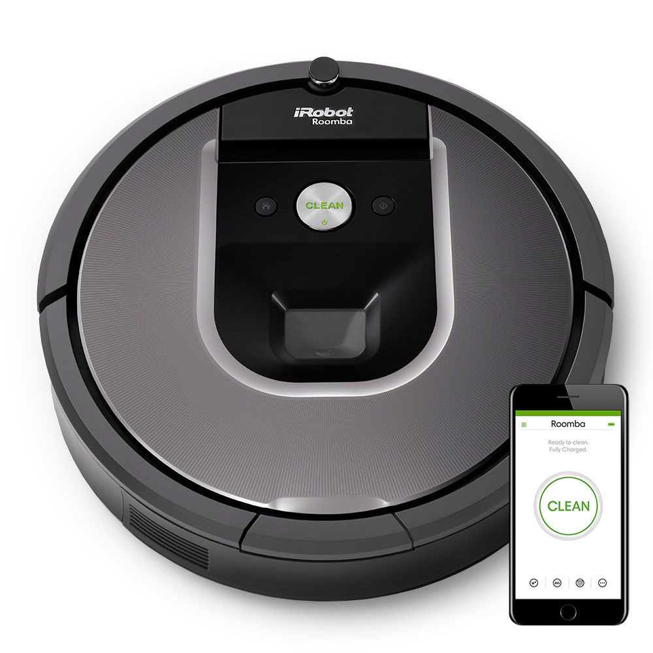
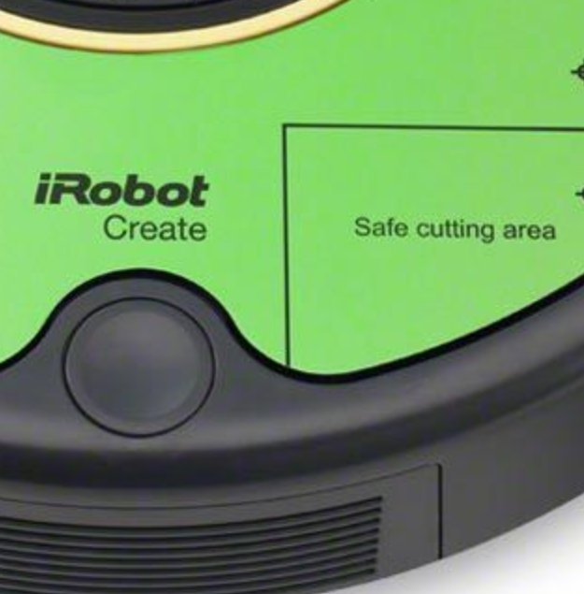
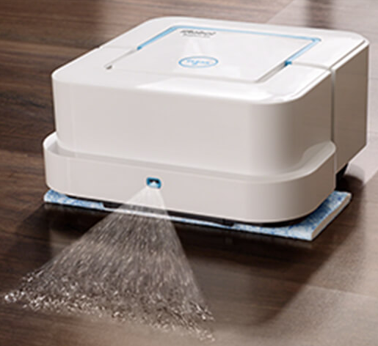
Company Briefing
Notes:
As a recap for the new investors in the room today, iRobot is a company that develops consumer robots with a goal to become a platform as a service company for the smart home. Founded in the early 90’s from MIT research labs, the company originally started developing military grade robots for the US government such as the Packbot pictured here which was used after the big earthquake in Japan at Fukushima. After developing the well-known Roomba line of home robotic vacuum cleaners, the company has since expanded into everything from mopping robots, pool cleaning robots, and even a robotics kit for educators to teach robotics in classrooms. We see a future of using our robots as part of a smart home by providing mapping and sensor data to other smart home providers and building a platform for the future.

Slide 4
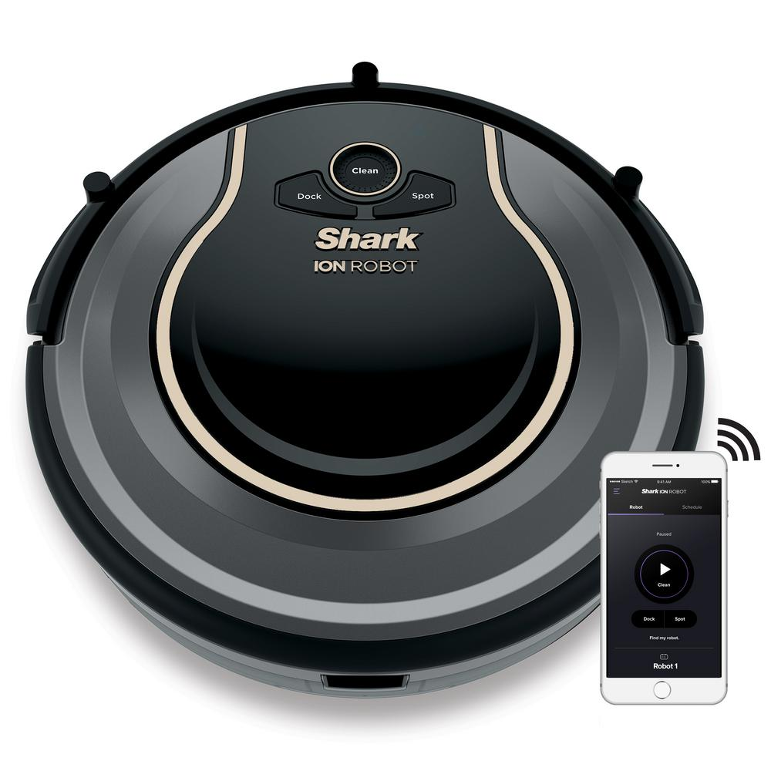
Company Briefing
Notes:
However, iRobot is not alone in this growing market anymore. The manufacturer of Shark vacuum cleaners called Shark Ninja (formerly Euro-Pro) has come out with very similar looking device at a lower price than most of the Roomba devices at $299 which our company has responded to by introducing a similarly priced vacuum based on older technology. On the other end, Dyson has released a high-end device at $999 that claims to have twice the suction of the our products. Our devices mostly fall into the middle price range from $299 all the way to $899, and investors are seeing risks to our position as the #1 robotic vacuum cleaner manufacturer in the world.

Slide 5
Financial Update
$69
per share
28M
shares outstanding
1.9B
market cap
Notes:
And as such, at the time of our last earnings release in February several analysts voiced their concerns of increasing competition in our sector and our stock price dropped over 30% in one day. It has since recovered somewhat and is again pacing with the S&P 500 (shown in grey) but is still down 30% from our high of $95 to $69 a share today. With 28M shares outstanding and a $1.9B market cap, we are still well positioned as a company to remain a force in the smart home market.

Slide 6
Sustainability Issues
Manufacturing Methods
Recycling & Product Disposal
Material Sourcing
Corporate Social Responsibility
Notes:
As discussed in our last meeting, I see four challenges around sustainability that our company will face in the coming years.

Slide 7
Sustainability Issues
Manufacturing Methods
Recycling & Product Disposal
Material Sourcing
Corporate Social Responsibility
Working conditions in countries with weak labor laws
Supply chain disruption
Consumer repair
In-house repairs
Battery disposal
Robot disposal
Mineral mines in conflict regions
Company perception
Commodity cost fluctuations
Competitive messaging
Regulatory disclosures
Notes:
The first area is around our manufacturing methods, which like many other consumer electronics companies are located in countries with less developed labor laws and leaves us open to risk of a supply chain disruption if unfavorable worker conditions or other factors result in a closure of our production lines.
Second is the increasing amount of our products needing repair either through direct-to-consumer parts or in-house repair services. This is where our competition has a perceived advantage over us especially in their warranty terms and e-waste disposal programs.
Third is our exposure to where we source our materials especially parts used in the circuit boards or batteries of our devices. In addition to company perception being affected if regional conflicts escalate, we run the risk of commodity costs fluctuating and hurting our bottom line.
Finally is our messaging around our environmental and social stewardship, which right now is underwhelming and in the future may not meet requirements of regulations in countries outside the US.

Slide 8
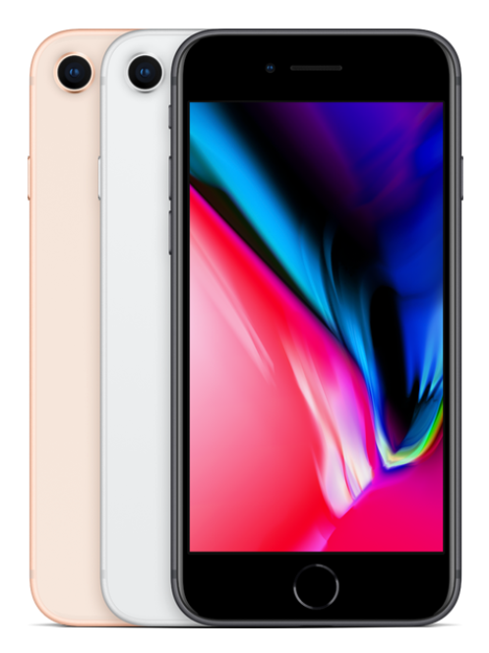
Proposal
Purchase outright: $699
AppleCare+: $129
Annual Upgrade Program: $34.5/mo. = $899 for two years
Refurbished one year old phone: $499
Notes:
So what can we do? If we continue to grow under our current business model, these risks will increasingly grow as well. In looking for a different model, I examined a more recently-developed model that exists in the cell phone industry by looking at another high-end consumer device producer: Apple.
Apple at the end of 2015 introduced its annual upgrade program in an attempt to change its relationship with its customers by offering a direct-to-consumer financing/subscription channel outside of the regular carrier’s programs. From a consumer’s perspective, instead of purchasing a phone outright for $699 and potentially signing up for Apple’s extended warranty program, they pay $34.50 a month over the next two years and are entitled to a new phone if they so choose but never outright-owning their current phone.
Likewise, once Apple receives their phone back, they are able to refurbish them and then resell them for 70% of the original sale price directly on their website.

Slide 9
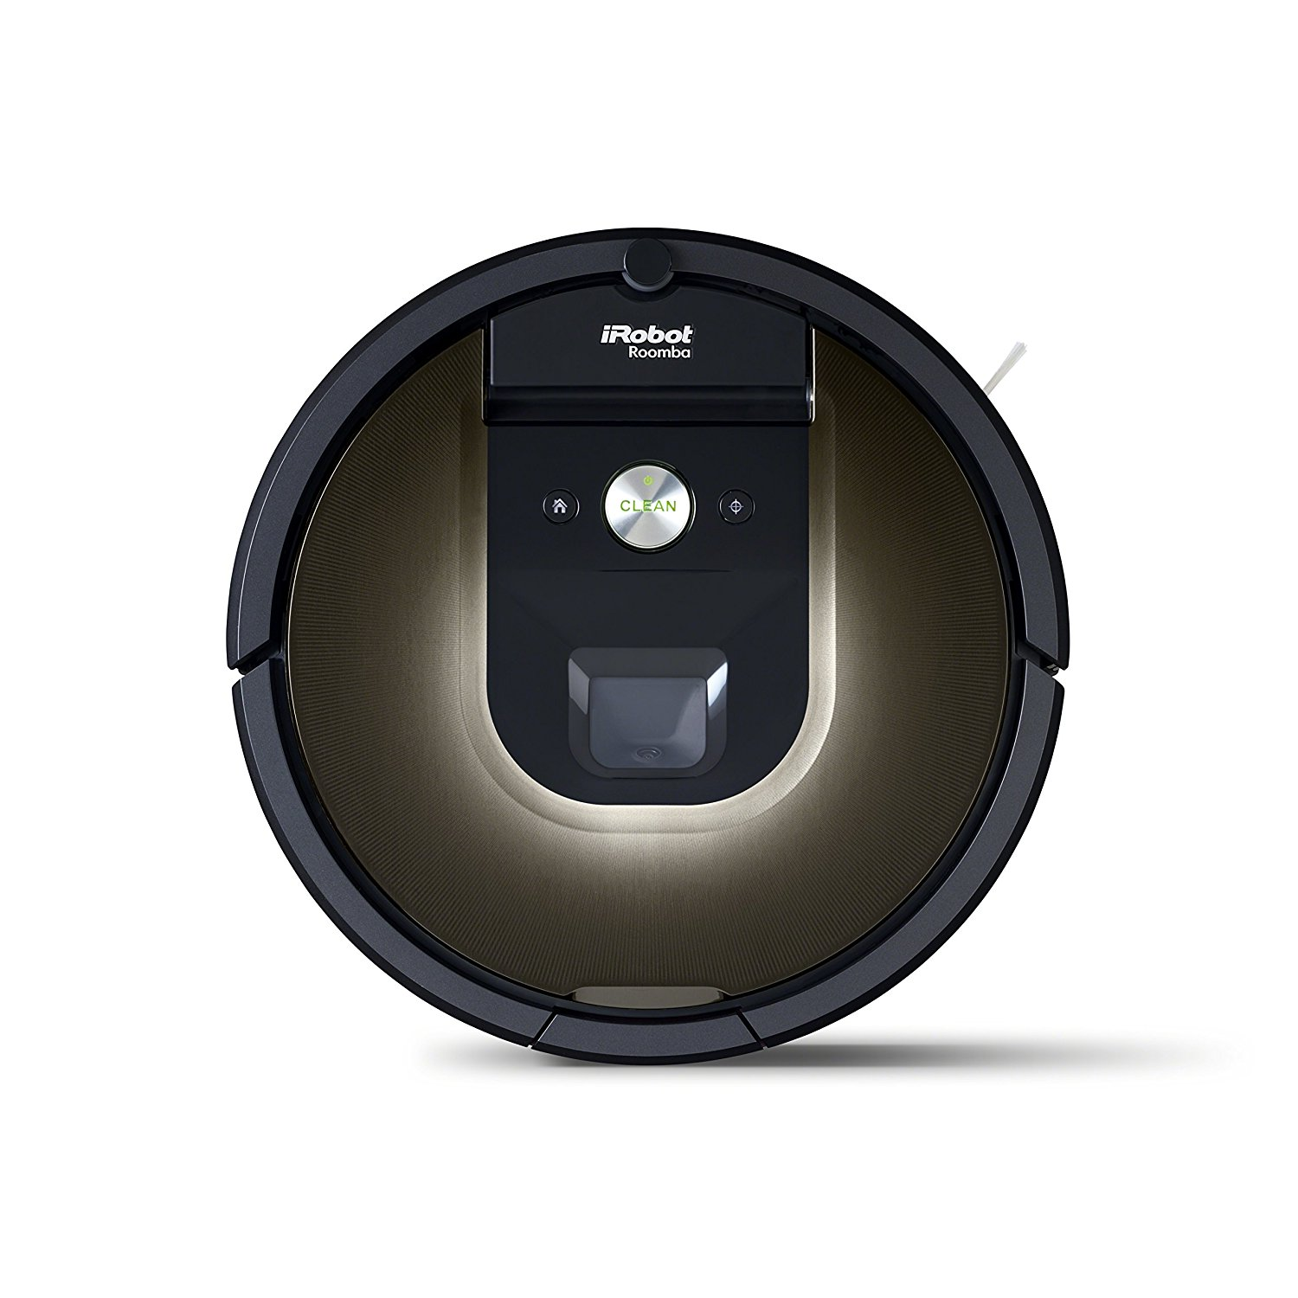
Proposal
Purchase outright: $899
SquareTrade 3 Year Warranty purchased separately: $30
Upgrade Program: $30/mo. = $1,080 for three years
Refurbished three year old device: $499
Notes:
Mimicking the Apple business model, I believe we’re able to offer a similar subscription model. We release new devices approximately every three years with our older models dropping down to a lower price point, and using this construct I believe we can offer our products for $30 a month and be able to resell them three years later for $499 or 55% of the original price instead of manufacturing additional SKUs.

Slide 10
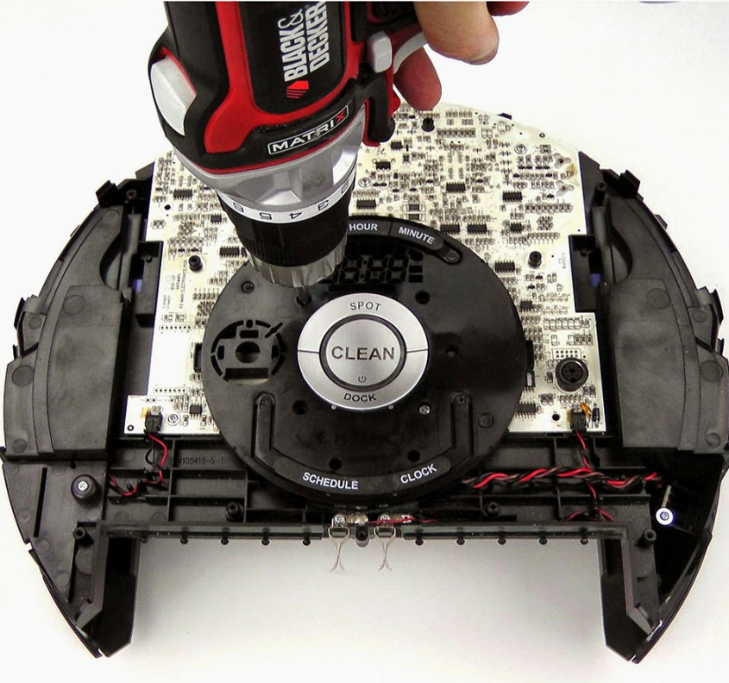
Proposal
vs.
$899
$1,080
($360/yr.)
-$50
refurb cost
$499
recertified
Up to $1,529
Notes:
So looking at the revenue stream from a per unit produced basis, instead of a single one time purchase per customer…a single device less the estimate refurb cost could be up to 70% more revenue for the company over three years.

Slide 11
Proposal
Customer
Monthly payments instead of upfront make it easier to afford
Always have the latest model and available technology for increased convenience
No-hassle repairs for any issues
Don’t need to find proper disposal facilities
Feel good about reducing e-waste through messaging as part of our marketing
Increased customer satisfaction from feeling protected from defects
Higher revenue per unit manufactured
Decreased likelihood customer switches to competitors after three years
Refurbishing workforce based locally reducing labor risk exposure
Less revenue risk for material cost fluctuations
Better CSR reputation with tie-in marketing campaign on reducing e-waste
Notes:
There are benefits of this both to our customers and iRobot itself.

Slide 12
Proposal
23
forward PE ratio
+368M
market cap at 10%
+1.1B
market cap @ 30%
Notes:
iRobot with over $130M in cash on its balance sheet would be able to smoothly introduce this program without risk to its cashflows from not receiving upfront payments. Then using the current WACC of 9.23%, I was able to calculate the present value of various scenarios. 10% of total units is about where Apple itself is after introducing the program for the past two years. At this level, I expect the delta in earning to be about $15M which using their current forward PE ratio would equate to about $368M of additional market value or $13 per share. As the program expands in the future and customers become more accustomed to the subscription model, I could see up to a 30% mix resulting in an additional $1.1B of market cap.
NOTES
Apple iphone current rate is around 10%: http://www.businessinsider.com/analyst-annual-iphone-sales-17-per-cent-apple-subscription-model-2017-12

Slide 13
Proposal
50-150K
fewer devices produced
200-600
tons of e-waste diverted
25-150
local jobs created
30-90K
kg of CO2 from shipping prevented
Notes:
On the sustainability side, I expect anywhere from 50-150K fewer devices produced compared to our current business model. The refurbishing activities would create 25-150 locally-based jobs that would scale with the program so not requiring an upfront fixed investment. In terms of sustainability messaging we would be diverting 200-600 tons of waste annually and reduce the amount of CO2 from shipping new devices from manufacturing facilities to local markets.
And in the spirit of our founding and aspirations to bring through robotics better lives for ourselves and our customers, this would be making a move towards protecting the planet which our company is a part of. Thank you for listening to this presentation and I would like to now open it up for questions.
NOTES
Per ton shipped, 150kg of CO2 for 5K km. China is 10k km away. https://www.freightos.com/portfolio-items/ocean-freight-explained/

Slide 14
