Slide 1
Sustainability Issues
Eugene Kow

Slide 2
Financial Update
$66
per share
28M
shares outstanding
1.9B
market cap
Notes:
Since the last month, the stock price of iRobot dropped a whopping -30% leading to a ton of articles including one from the Motley Fool (link). Despite still showing massive revenue growth in the past quarter and raising its full year revenue range, its earnings per share was lower than investors were expecting. The company's CEO clarified that with "the market accelerating in its growth and competitive pressure coming into the markets, we made a choice to double down on ensuring we had adequate dry powder to drive that top-line growth."
Investors interpreted this as acknowledging that the larger-sized competitors of Shark and Dyson are ramping up their efforts, and that the long term potential of this company might be at risk. While iRobot is recognized in the robotic vacuum space, these other competitors are more broadly recognized as top-tier vacuum makers, especially Dyson with its innovative mechanical design. Thus, it makes sense the stock price which represents future earnings took a dip despite the company focusing even more on R&D and product development.

Slide 3
Manufacturing Methods
Recycling & Product Disposal
Material Sourcing
Corporate Social Responsibility

Slide 4
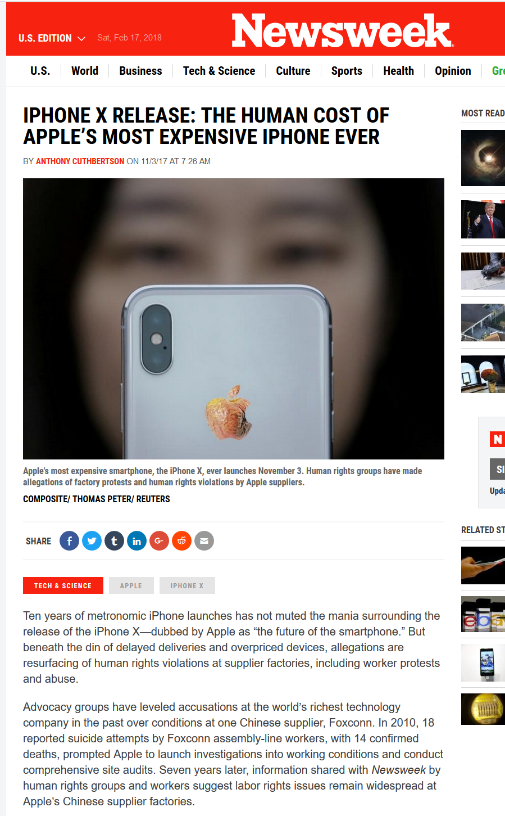
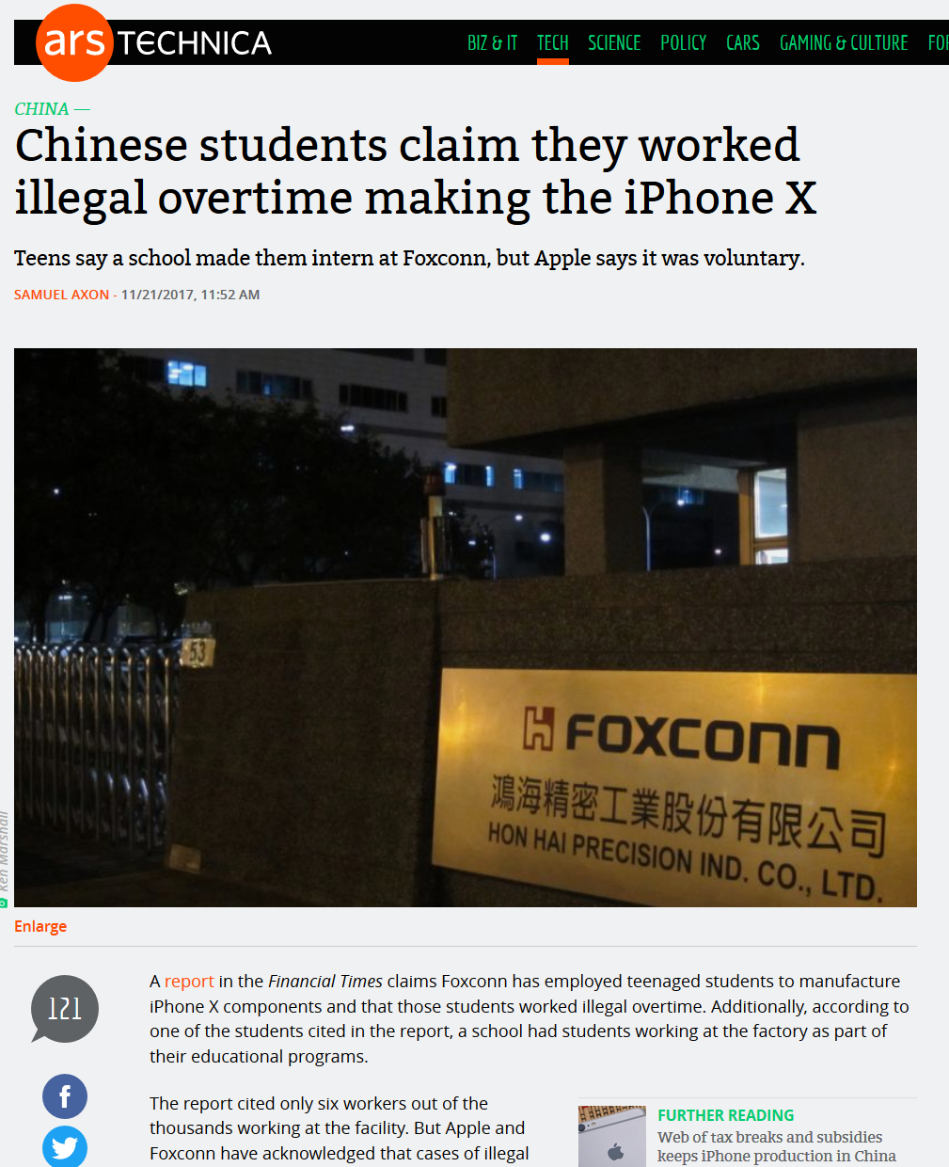
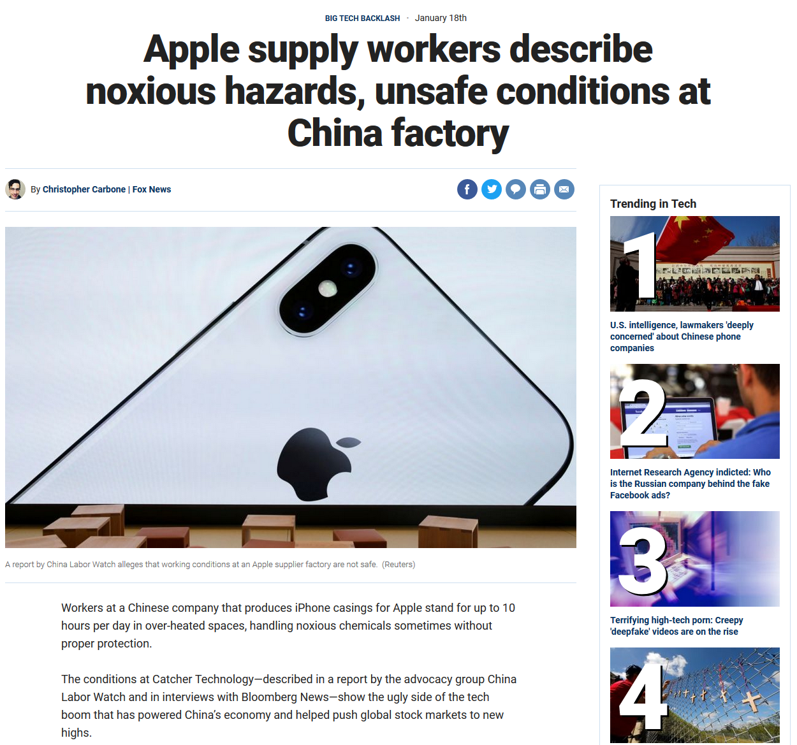
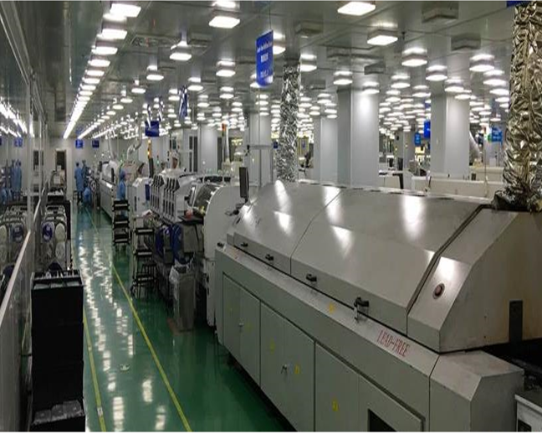
Manufacturing Methods
Recycling & Product Disposal
Material Sourcing
Corporate Social Responsibility
iRobot Plants in China
Next steps: understand cost of relocating manufacturing regionally to America/EMEA, associated de-risking of what % of workforce
Notes:
(2) Manufacturing methods. Like most consumer electronic products, iRobot's products are manufactured in China (link) and thus issues around minimum wage, living conditions, working conditions, child labor laws, etc. that have been reported for other American companies like Apple could at some point become an issue. Also, since they outsource their manufacturing, any disruption in its manufacturer's financials or workforce could cause price/quality spikes with its products and drive costs up or perception issues with consumers.

Slide 5
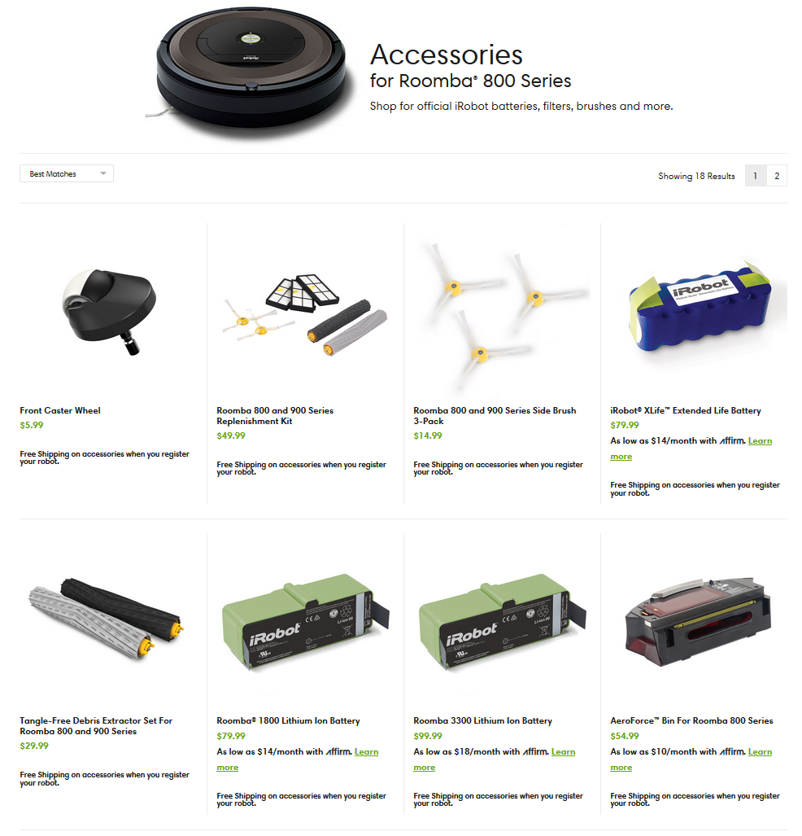
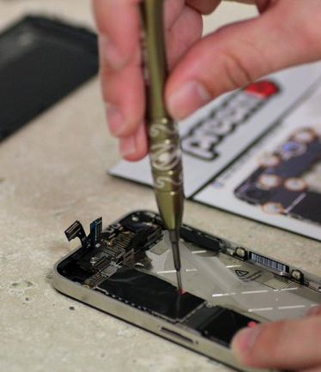
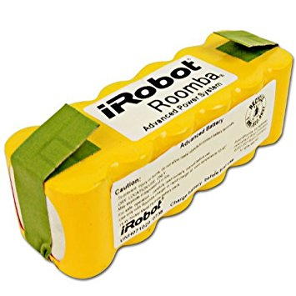
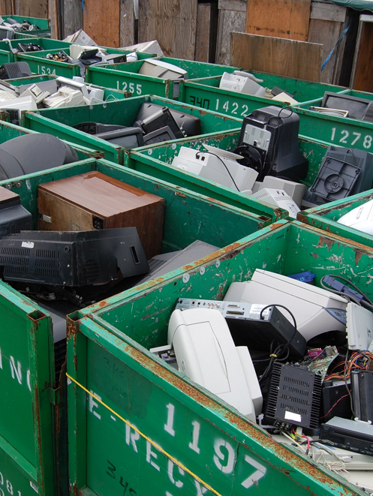
Manufacturing Methods
Recycling & Product Disposal
Material Sourcing
Corporate Social Responsibility
Consumer Repair
In-house Repair
Battery Disposal
Robot Disposal
Next Steps: calculate projected costs of repairs with an expanded warranty, possible revenue from expanded remanufacturing program
Notes:
(2) Recycling & product disposal. The machines that iRobot manufactures contains not just the regular electric motor, plastic, and metal that most vacuums come with, but instead e-waste such as circuit boards, lithium batteries, etc. Depending on how customers either send back devices that are broken or unused, iRobot will need to have a process to handle the proper disposal of such waste in accordance to local laws. With the increase in revenue volumes of 30-50% per year, this could become a much larger problem very soon. CENTRALIZED REPAIRS already identified as a profitability improvement in its investor deck.
Today iRobot has four avenues for servicing/disposing of its robots:
It offers an online parts store where consumers can buy parts as well as some basic guides as to how to fix at home.
Additionally, a customer can contact iRobot customer care for in-house repairs which likely services the 30-day full warranty and 1-year limited warranty. This pales in comparison to Dyson who offers a 5-year limited warranty and having entered the market may drive the expectation for longer warranties and better lasting products.
Each Roomba comes with batteries which are known for their toxic materials. Today, these are commonly disposed of through local recycling programs.
Finally, once the Roomba reaches end of life, iRobot recommends disposing of it in conventional manners. Most consumer electronics companies (Apple, Sony, Dyson) offer returns of old products either to their retail stores or paid postage to a certified recycling contractor with some even giving store credit for returns. iRobot does have a remanufacturing program but it doesn’t look like it is actively taking back old products.
https://www.treehugger.com/gadgets/irobot-says-just-throw-your-broken-scooba-in-the-garbage-we-have-5-better-ideas.html

Slide 6
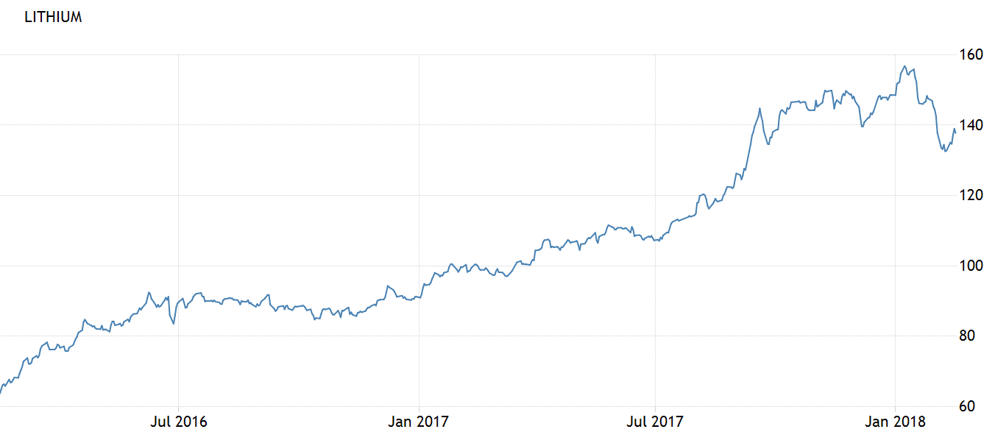
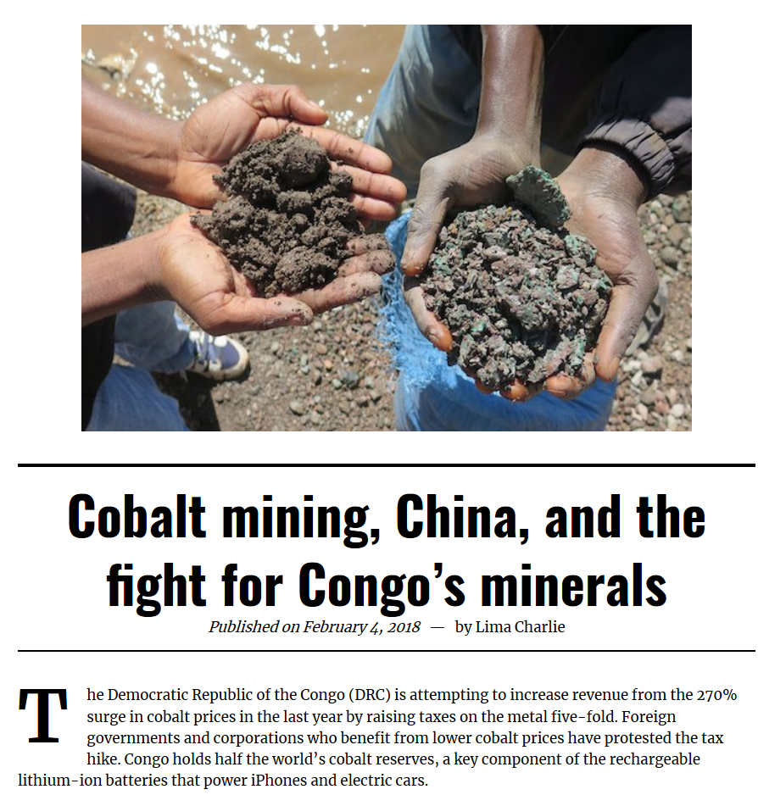
Manufacturing Methods
Recycling & Product Disposal
Material Sourcing
Corporate Social Responsibility
https://tradingeconomics.com/commodity/lithium
Next Steps: understand impact of remanufacturing or recycling materials, the PR costs associated with acquiring freshly-mined minerals
Notes:
(3) Material sourcing. The company also discusses its efforts around conflict minerals (link) and requires its suppliers to ensure they are not sourcing from this particular region in the Democratic Republic of Congo. The company specifically uses gold, tin, tantalum, and tungsten in its products, and any changes in supply or demand of these minerals could cause risk to profitability and company perception among consumers for its efforts to responsibly source.

Slide 7
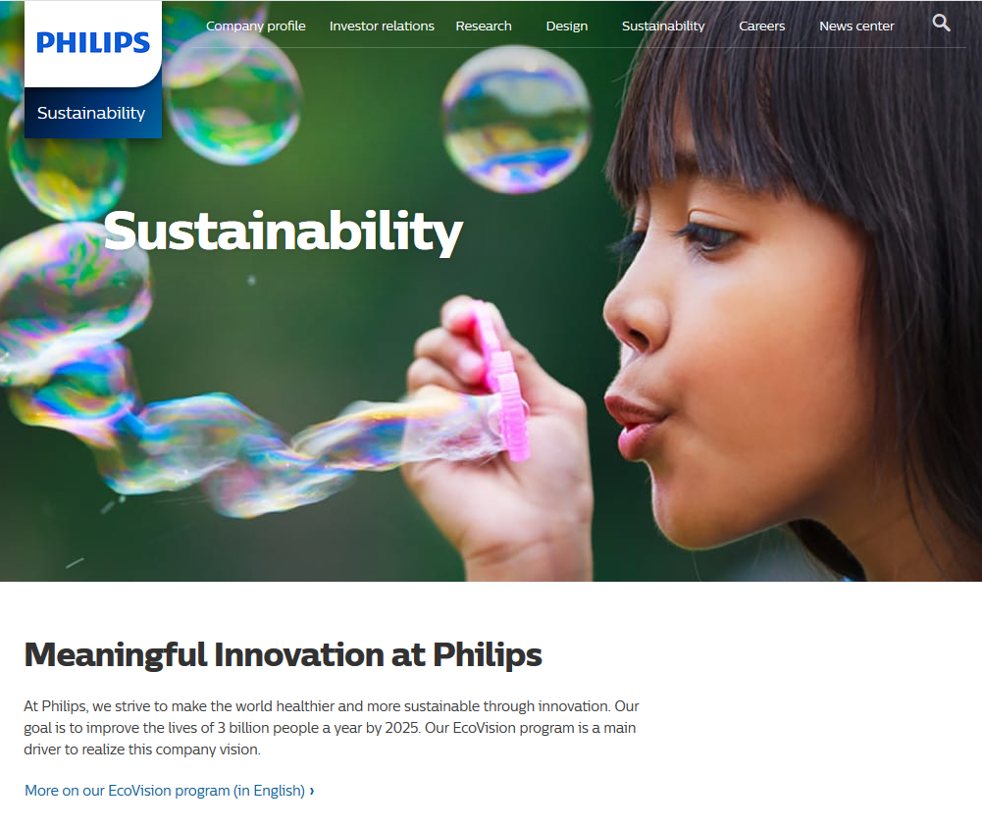
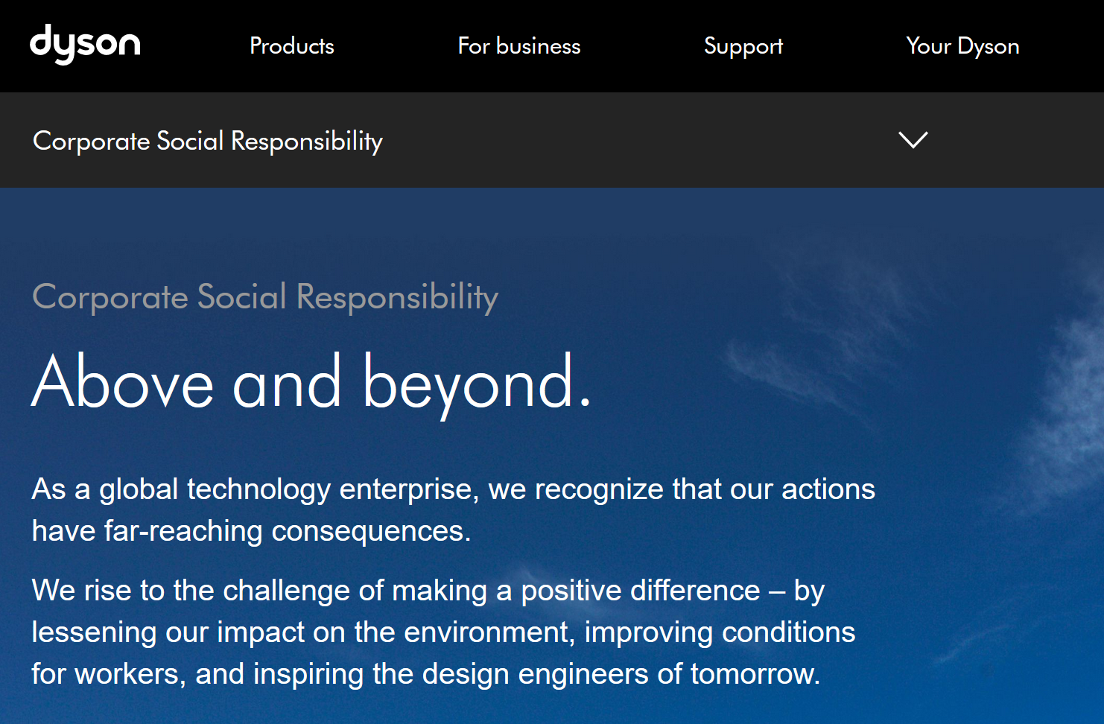
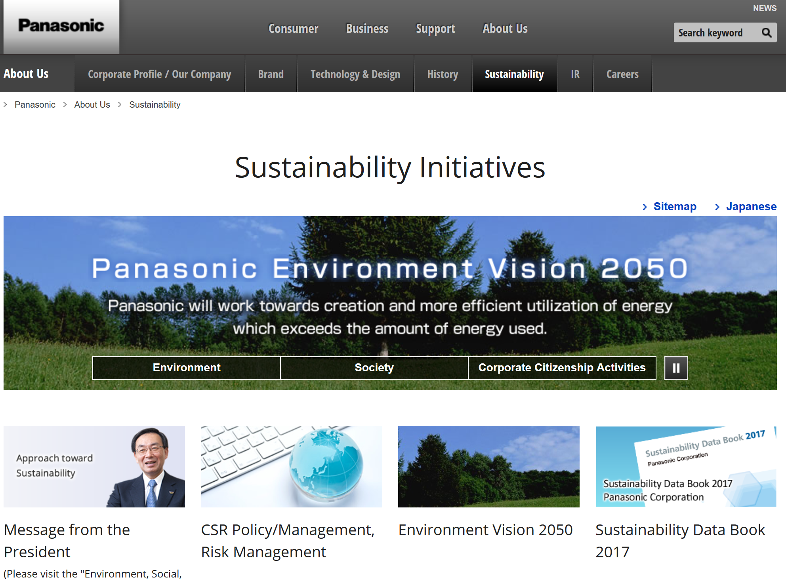
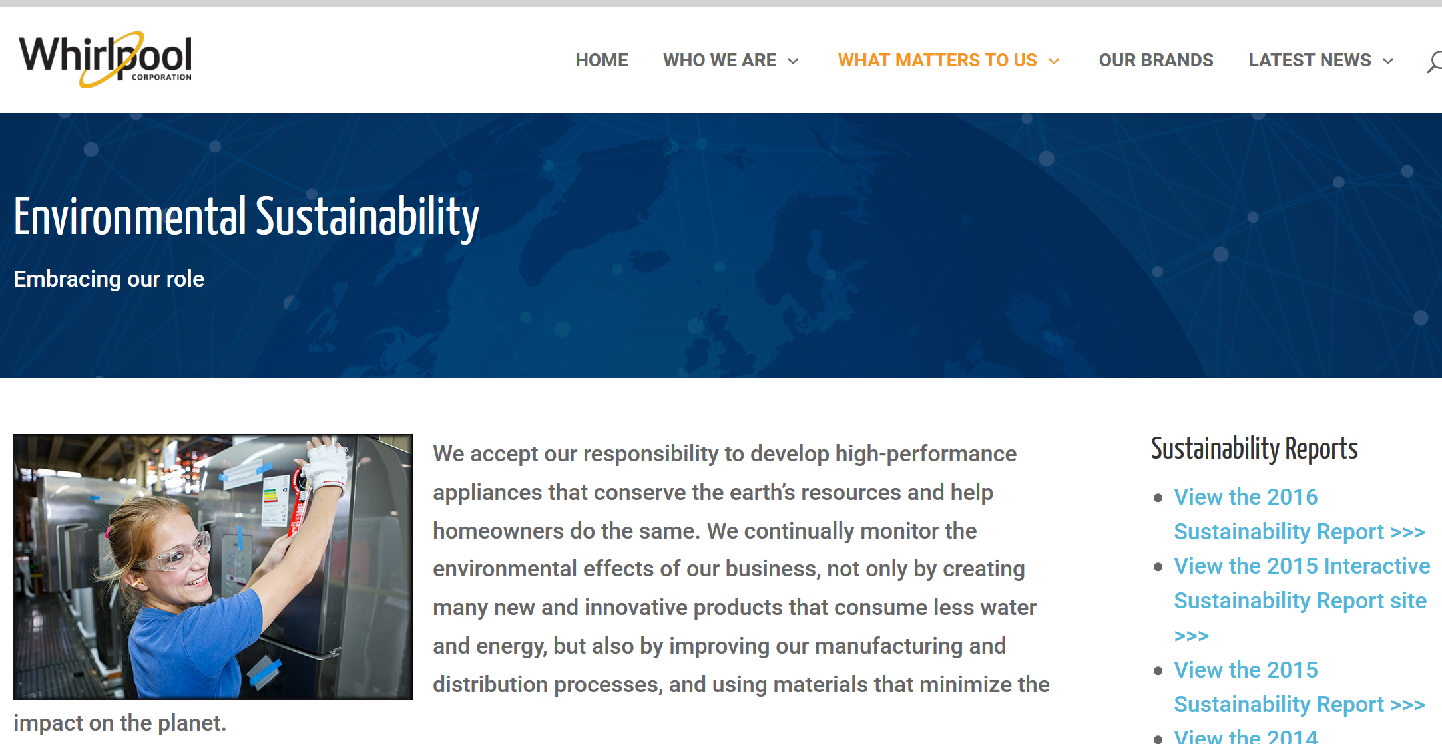
Manufacturing Methods
Recycling & Product Disposal
Material Sourcing
Corporate Social Responsibility
Next Steps: cost to create a public-facing CSR team vs. possible strengthening of market position relative to competitors
Notes:
(5) Corporate Social Responsibility. Compared to competitors like Dyson (link), iRobot barely discusses these above issues outside of the required regulatory disclosures. Without a proper communication channel to consumers and regulators, this could leave iRobot behind its peers when regulations change or if consumer expectations shift dramatically as it has in other industries. However, currently consumers don't necessarily get this information as part of any purchasing platform (brick & mortar retail, Amazon, etc.) so this may be only important to a particular set of LOHAS-focused ones.

Slide 8
Wrap-up Q&A

