Slide 1
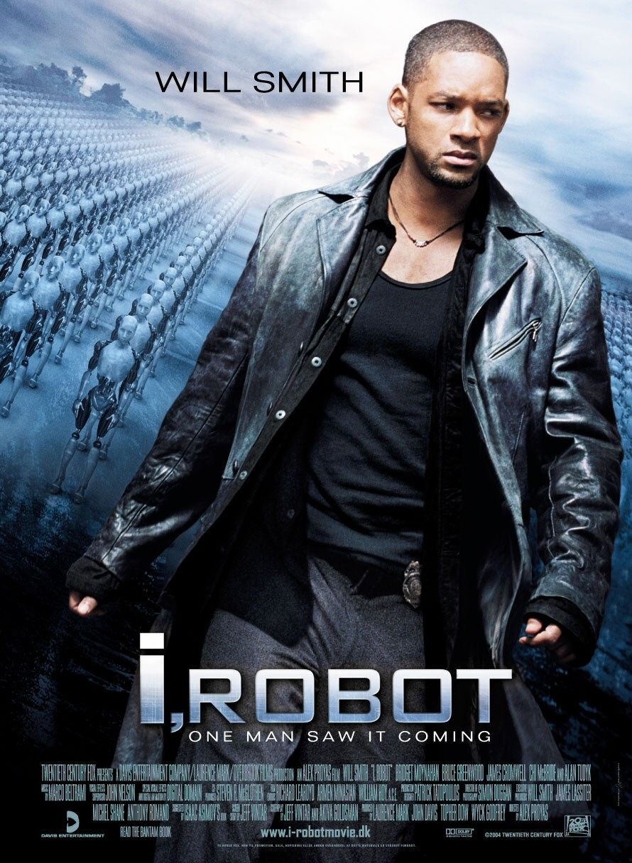
FIN 562 Valuation
Eugene Kow

Slide 2
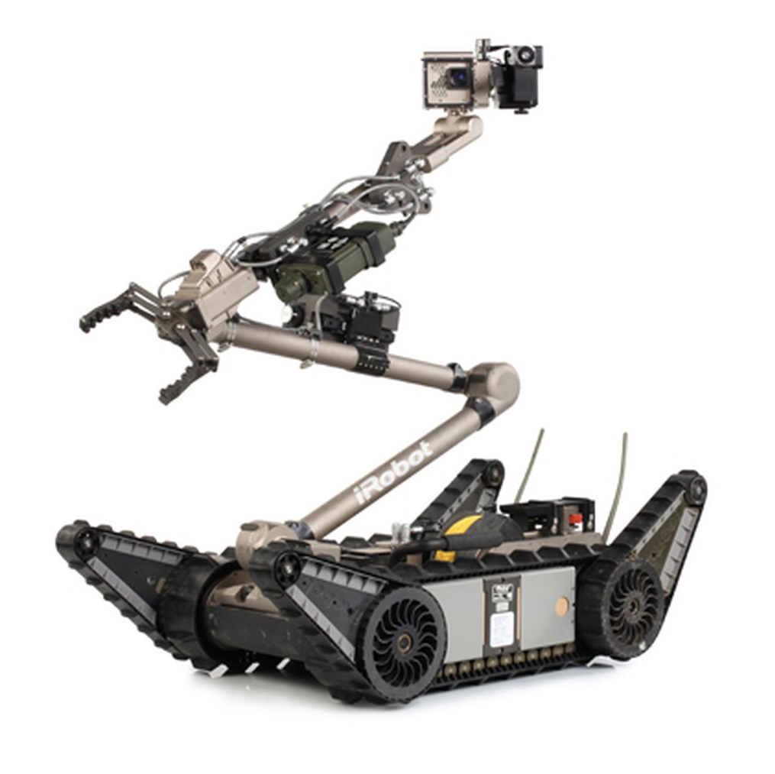
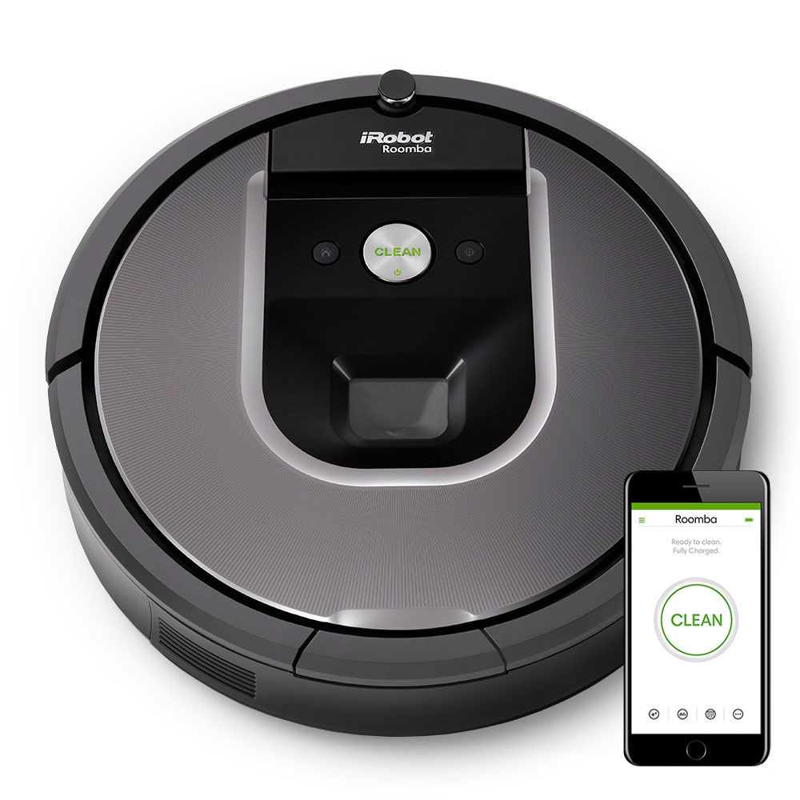
History
Founded in 1990 by three MIT graduates who designed robots for defense/space exploration, turned into a consumer company
1998 received DARPA grant which created PackBot
2002 released first Roomba
2005 IPOed on NASDAQ
2012 acquired maker of robotic floor moppers
2016 sold military robotics business

Slide 3
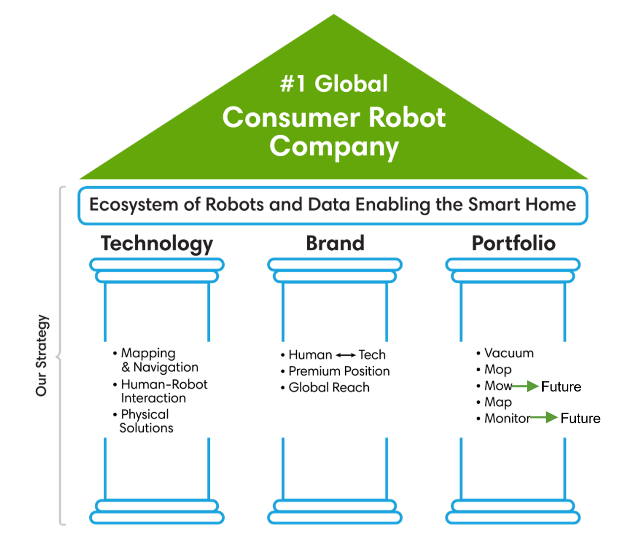
Notes:
iRobot’s strategy to be the #1 consumer robot company across the globe. They see their initial ecosystem of robots expanding into providing mapping and sensor data to other parts of the smart home ecosystem, which in the long run could open access to an even larger market outside Robotic Vacuum Cleaners.

Slide 4
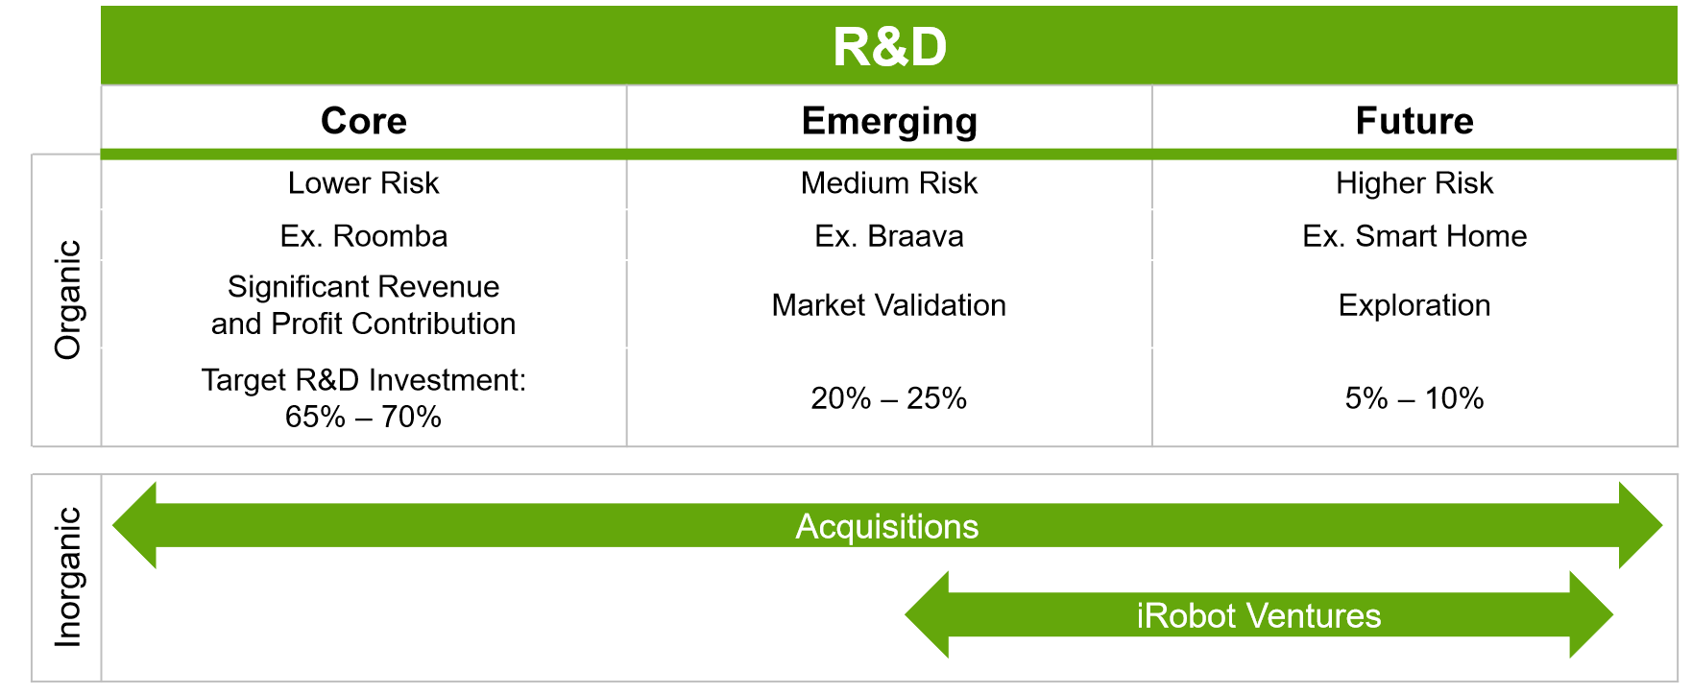
IP – A Key Differentiator
Ranked #5 in 2016 in Top 20 patent powerhouses by IEEE
Will vigorously defend its IP and continues to widen the competitive moat
Segments it R&D spend to keep generating IP in addition to planning acquisitions and running its own venture capital firm

Slide 5
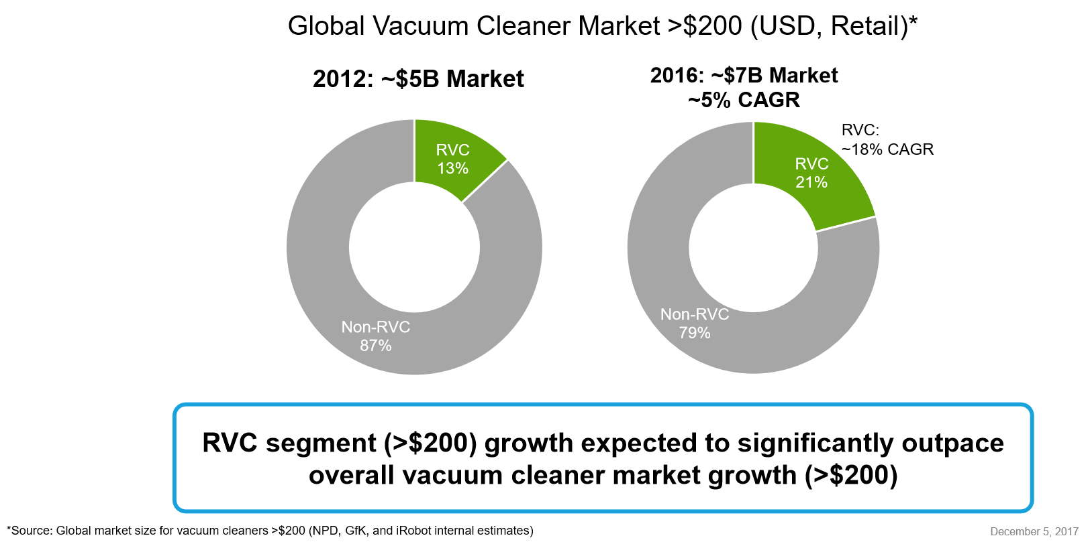
Robot Vacuum Cleaner (RVC) Market

Slide 6
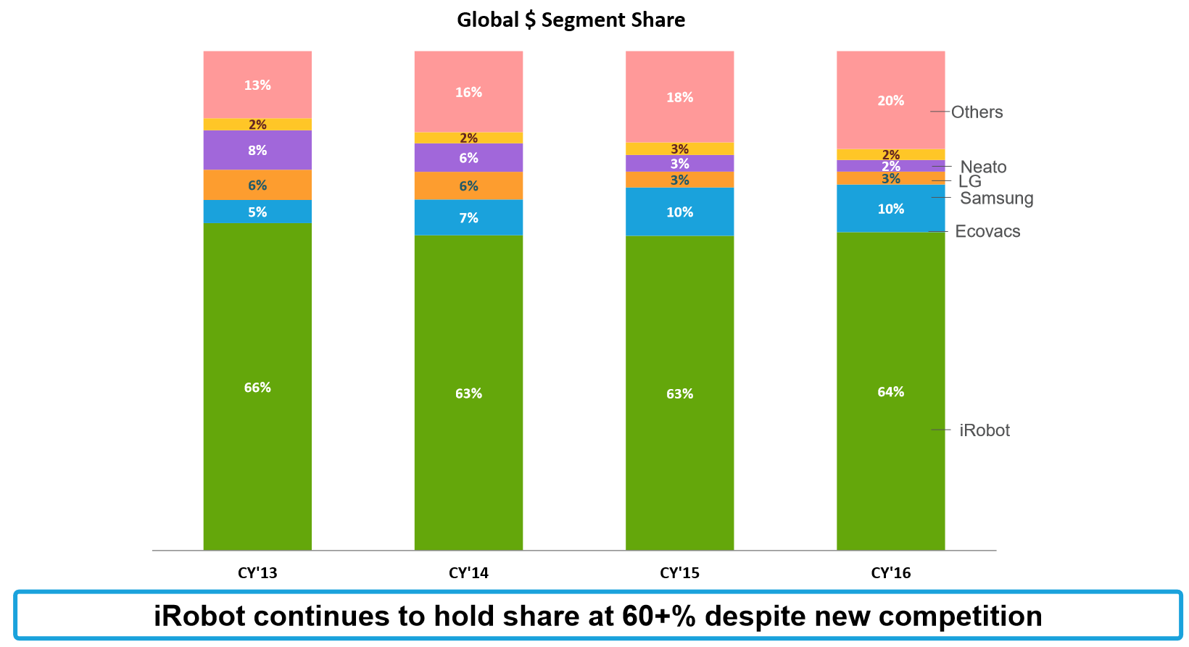
iRobot Share of RVC Market (KPI)
Notes:
Market share is a key performance indicator for iRobot. The iRobot Roomba share in the robot segment remains constant despite the introduction of new players. This implies that their brand is strong

Slide 7
Strong earnings
Acquisition
Softbank stake
+21% price jump
Volume: 15.1m
Google buys Boston Dynamics
+16% price jump
Volume: 13.3m
IPO @ $37
Volume: 17.7m
Invests in healthcare robots
-32% price drop
Volume: 10.4m
SharkNinja Entrant
Analyst Downgrade
-31% price decline
Volume: 16.2m

Slide 8
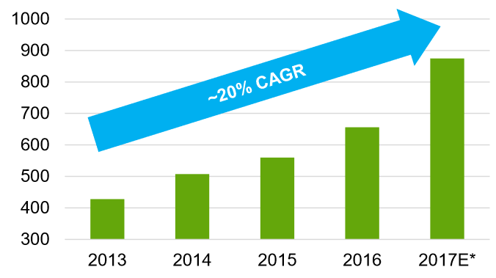
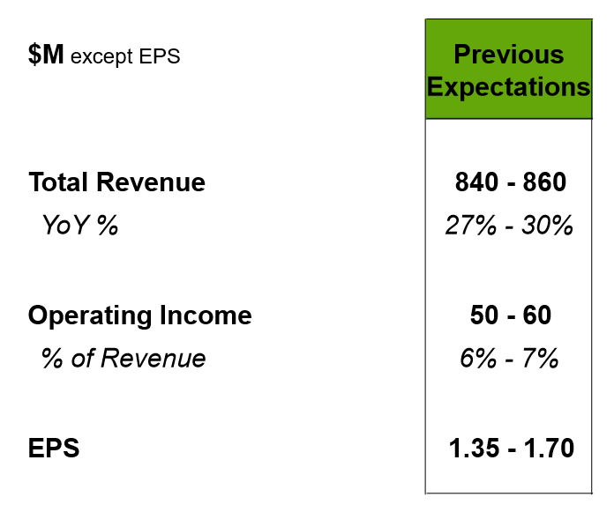
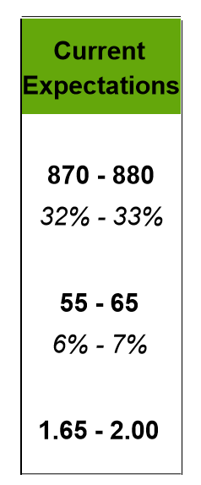
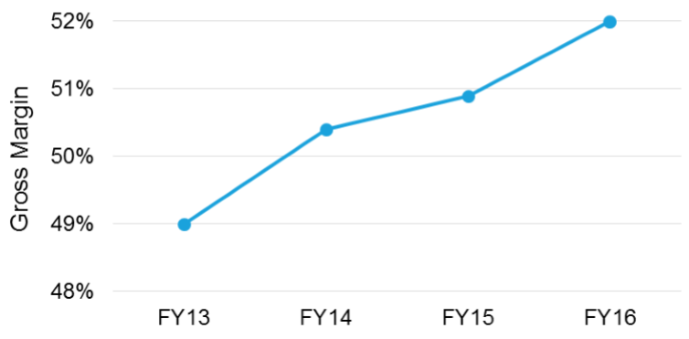
Investor Day: Revenue, Margin, EPS
Revenue
Stock Price: $88.79
Shares Outstanding: 27.87m
Market Cap: $2.47b
Notes:
iRobot in their latest investor day disclosed some key metrics that position it as a growth company rather than a value one:
Revenue is growing 20% CAGR vs. a 5% CAGR of the premium vacuum market
Gross margin continues to improve as it sells more premium products and improves on its manufacturing efficiency
It also revised its guidance for the 2017 year to nearly 33% YoY growth and a +17% improvement on its earnings per share driven by the improved revenue outlook.

Slide 9
Competitor Benchmark
Company | Forward P/E | Price/Sales (ttm) | Market Cap | Revenue (ttm)
iRobot | 33.25 | 3.22 | 2.47b | 769.51m
Philips | 19.64 | 1.26 | 31.32b | 24.88b
Whirlpool | 10.83 | 0.57 | 12.04b | 21.21b
Emerson Electric | 21.83 | 3.06 | 46.71b | 15.26b
General Electric | 16.10 | 1.16 | 141.01b | 121.31b
Sony | 17.26 | 0.85 | 63.41b | 74.33b
Notes:
iRobot is somewhat unique in its space being a public company with such a niche product. Most of its other competitors in consumer robotics or home cleaning appliances are large conglomerates. In fact, its largest competitor in the RVC category by percentage market share (10%) is Samsung, a chaebol from Korea and makes everything from semiconductor chips to cars.
Thus iRobot which has been positioning as a future growth company sees the highest Forward P/E and Price/Sales of its more established and diversified competitors despite having the smalles market cap and revenue by a factor of 10x.
http://www.nasdaq.com/symbol/irbt/competitors

Slide 10
Factors That Influence Share Price
Positive
Negative
Revenue and earnings growth
RVC market growth
IP wins against competitors
Launch of new products
Potential acquisition target
Competitors especially at lower price points
Weakening of IP laws
Reliability issues with products, other brand damage

Slide 11
Thank You

Slide 12
